Slide 1
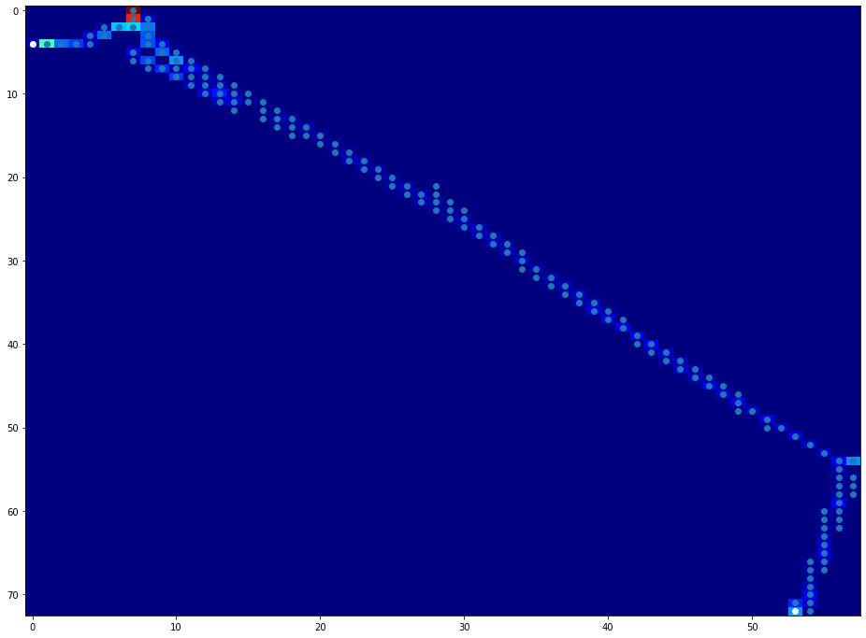
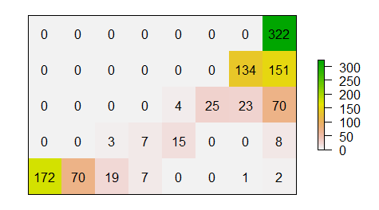
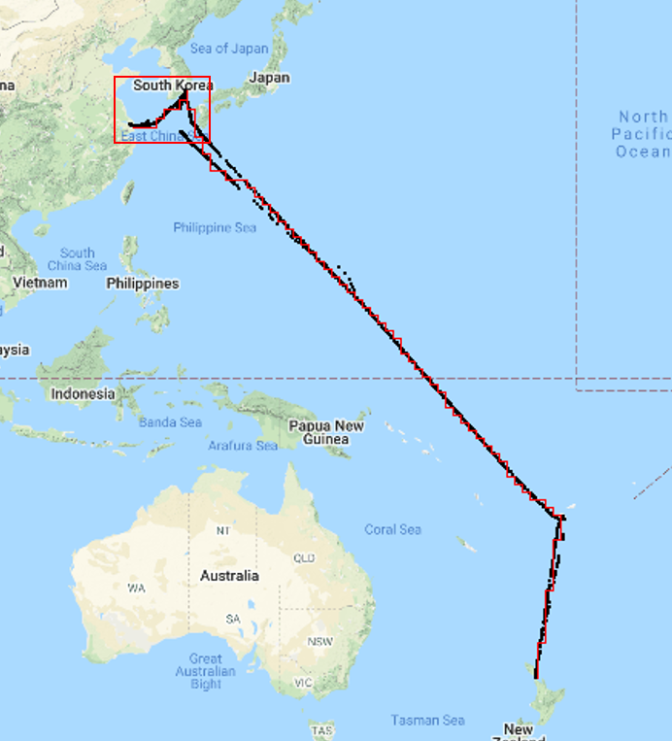
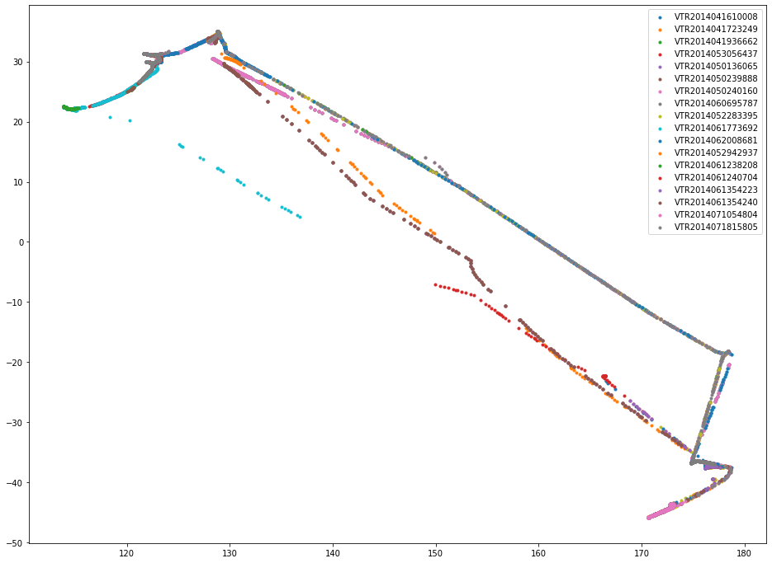
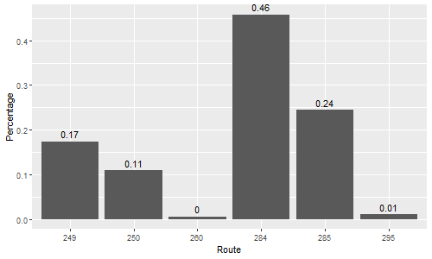
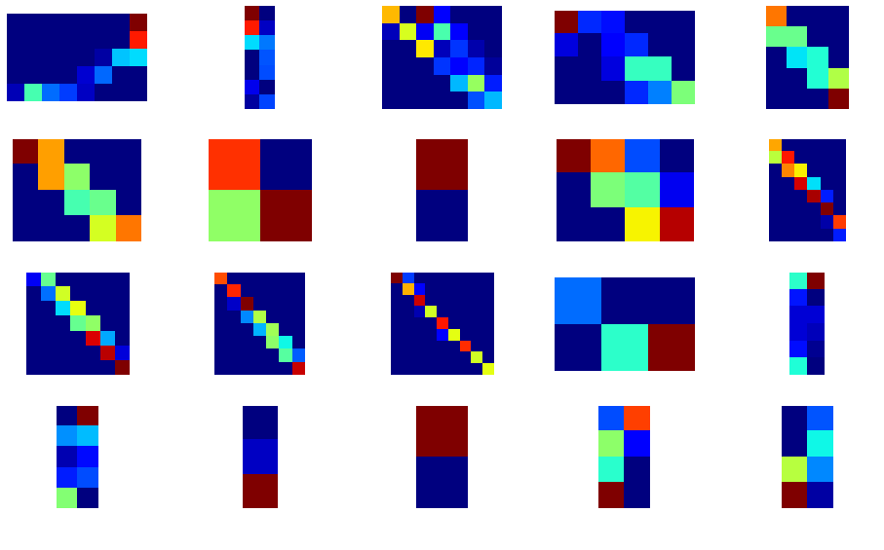
Analyze the routes in the gird
Find Intermediate Nodes
Find the best route using Bootstrap
…
(a) AIS data preprocess
(b) Sub-divide into grids
(c) Find best routes in all grids
(d) Construct Baseline merging best routes

Slide 2
Analyze the routes in the gird
Find Intermediate Nodes
Find the best route using Bootstrap
…
Divide into grids
Iterate to find best routes in all grids

Slide 3
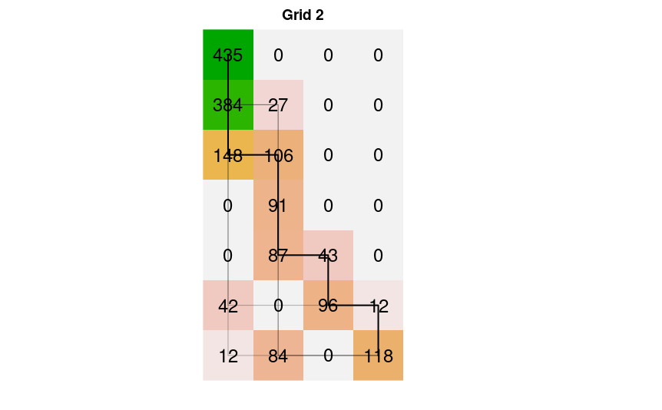
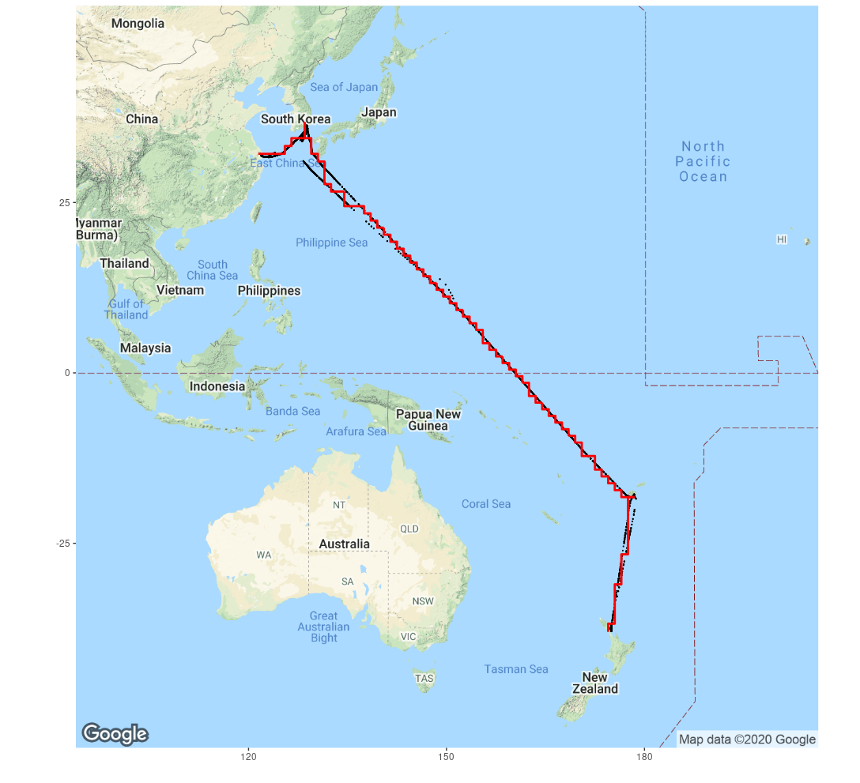
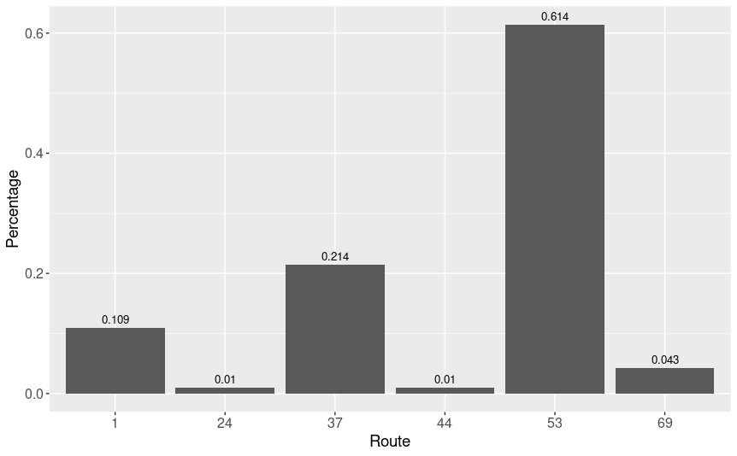
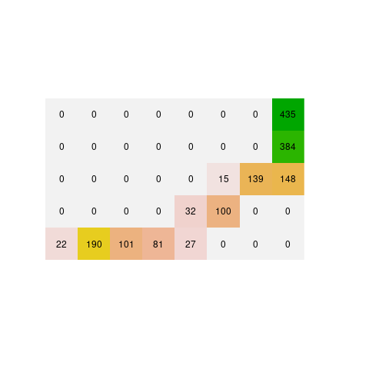
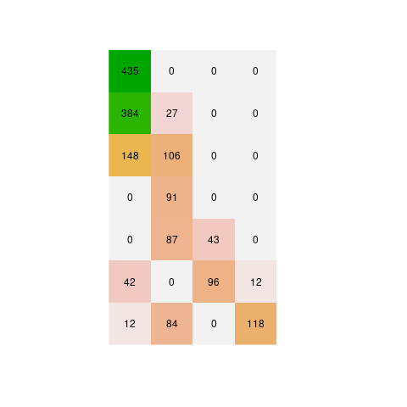
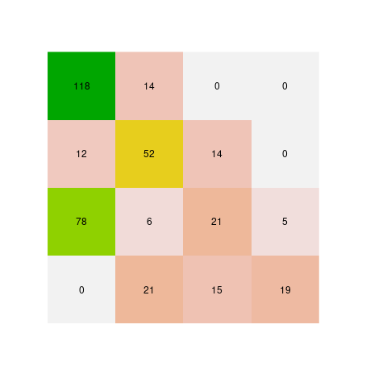
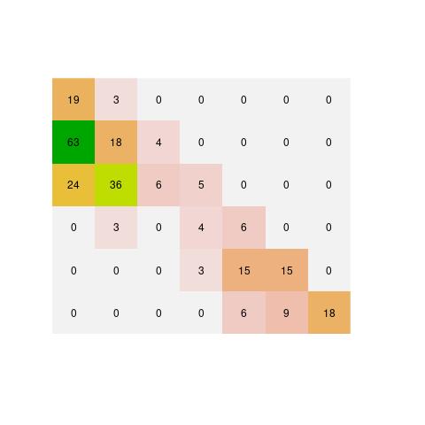
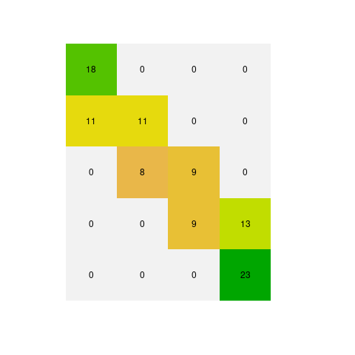
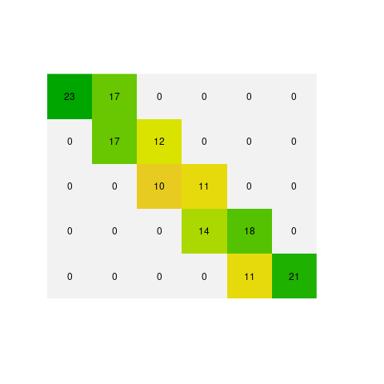
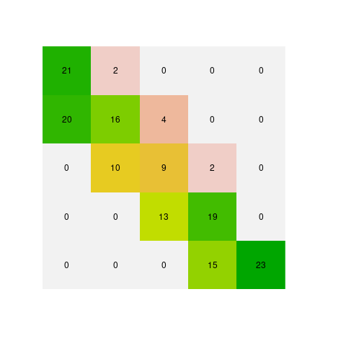
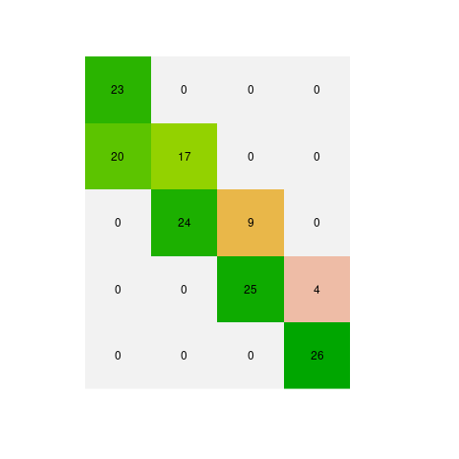
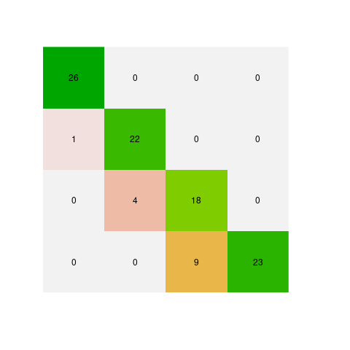
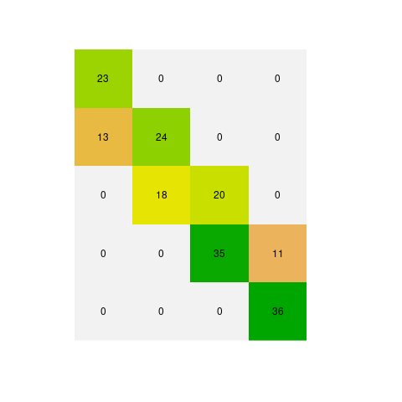
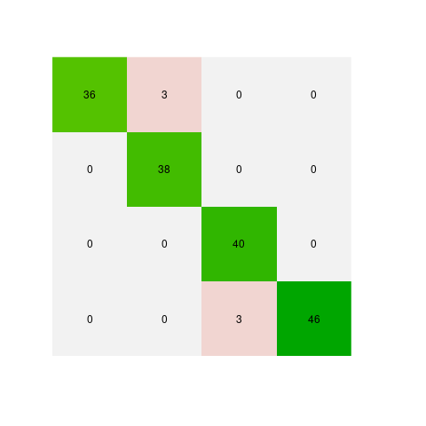
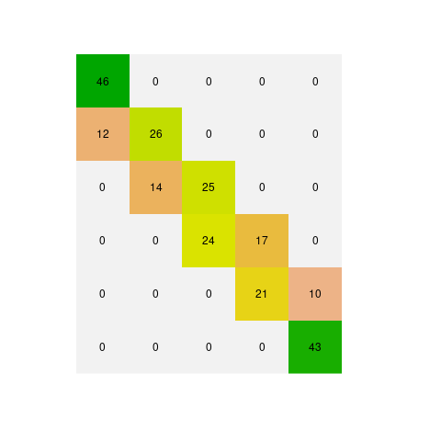
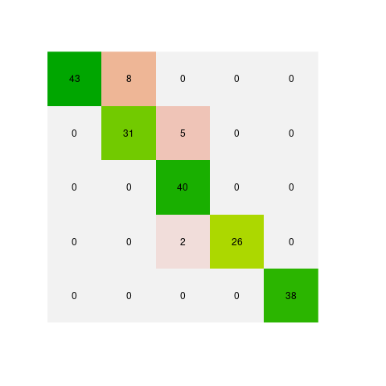
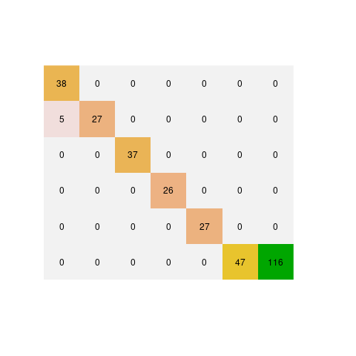
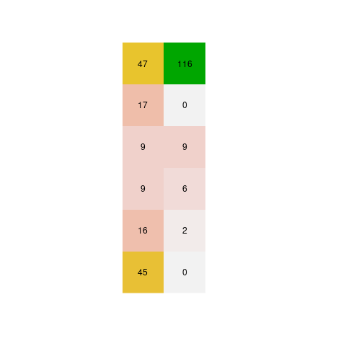
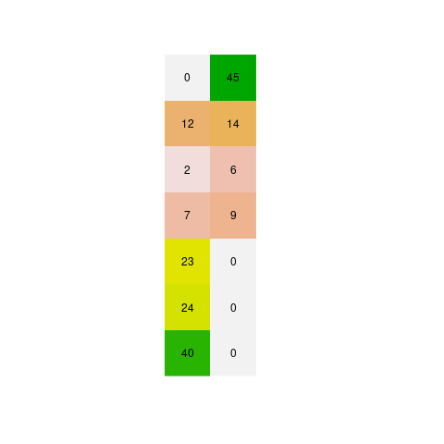
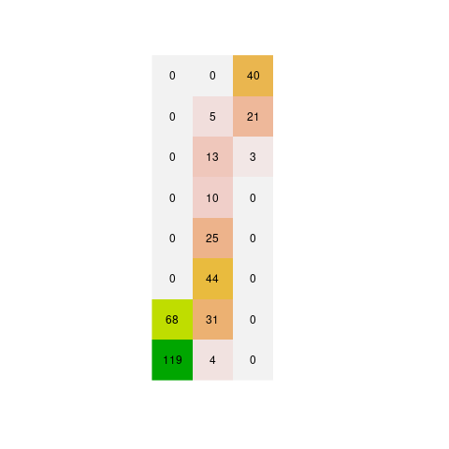
Analyze the routes in the gird
Find Intermediate Nodes
Find the best route using Bootstrap
Divide into grids
Iterate to find best routes in all grids

Slide 4
Analyze the routes in the gird
Find Intermediate Nodes
Find the best route using Bootstrap
Divide into grids
Iterate to find best routes in all grids

Slide 5
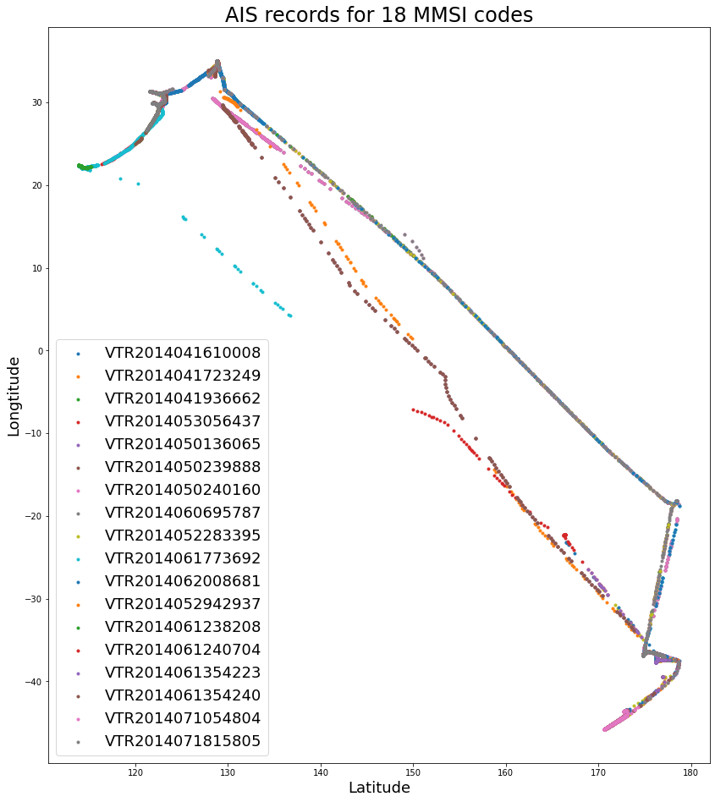

Slide 6
Analyze the routes in the gird
Find the best route using Bootstrap
Iterate to find best routes in all grids

Slide 7
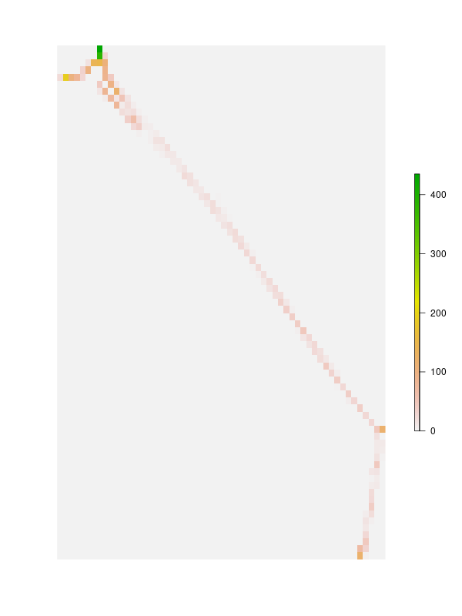

Slide 8
AIS 데이터 전처리
데이터를 기반으로 주요 경로점 선택
주요 경로점 기준으로 하위 격자로 분리
하위 격자에서 경로 탐색
예측 가능한 경로의 선택 확률 계산
모든 하위 격자에 대해 경로 탐색 및 확률 계산 수행
계산된 확률을 사용하여 기준 항로 설정

Slide 9
AIS data preprocess
Find Intermediate Nodes (Waypoints)
Divide into sub-grids
Find Baseline
Calculate probability
using Bayesian Bootstrap
Iterates for all sub-grids
Determine baseline for whole travel space

Slide 10
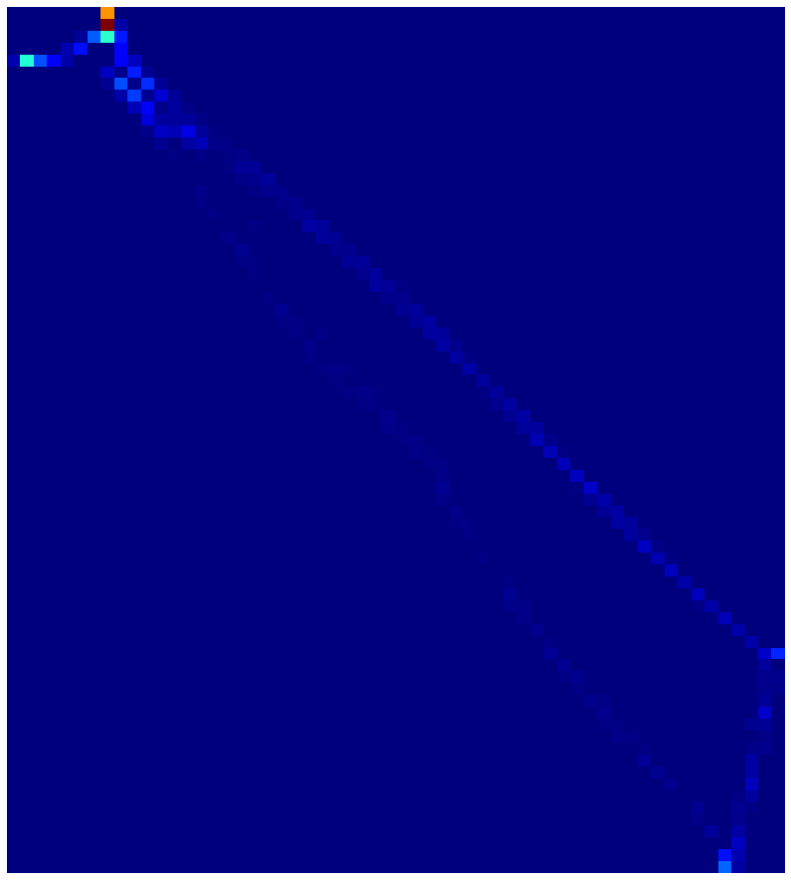
AIS data preprocess
Find Intermediate Nodes (Waypoints)
Divide into sub-grids
Find Baseline
Calculate probability
using Bayesian Bootstrap
Iterates for all sub-grids
Determine baseline for whole travel space

Slide 11
AIS data preprocess
Find Intermediate Nodes (Waypoints)
Divide into sub-grids
Find Baseline
Calculate probability
using Bayesian Bootstrap
Iterates for all sub-grids
Determine baseline for whole travel space

Slide 12
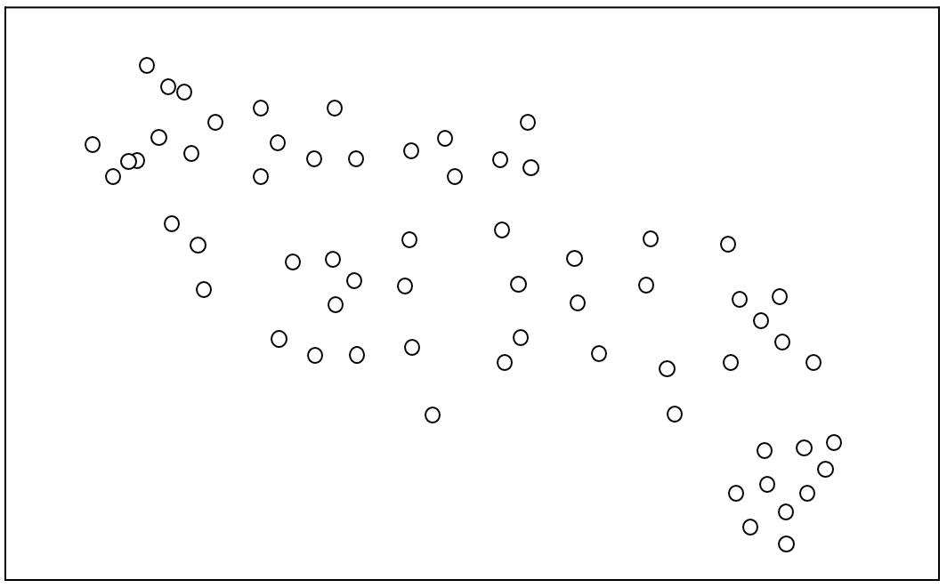
Latitude
Longitude

Slide 13
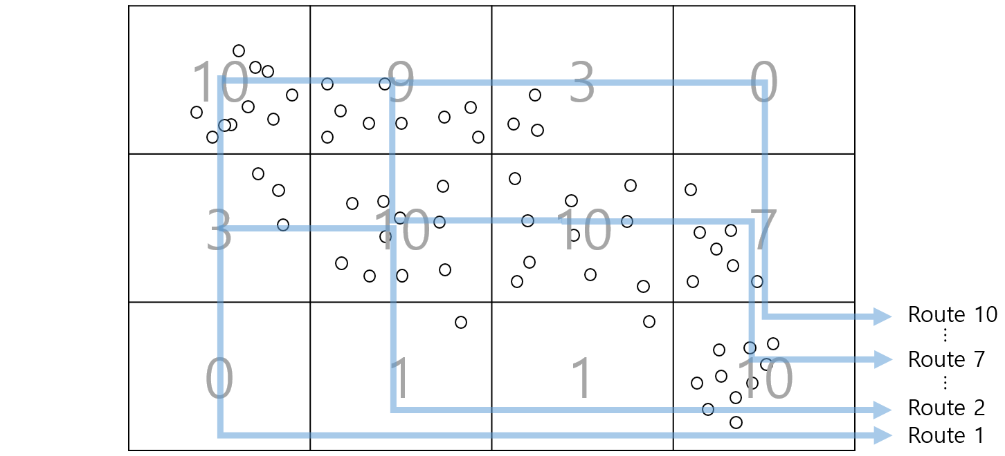
Latitude
Longitude

Slide 14
Latitude
0
1
2
3
4
1
Longitude
2
3

Slide 15
Latitude
0
1
2
3
4
1
Longitude
2
3

